Slide 1

Scalable AI for Good in Genomics and Health
February 11, 2022 | Colby T. Ford, Ph.D.

Slide 2
Overview
About Me
AI Advancements
Structure Prediction
Cloud Scalability
Explainable ML
Impacts
Drug Discovery
Public Health
Designing Diagnostics

Slide 3
With advancements in cloud computing and AI technologies, we can now explore the complexities of disease diagnostics and prevention, innovate on new therapeutics, and investigate the severity of evolving issues such as COVID-19, all without setting foot in a lab. In this talk, we will walk through the in silico ways we’re tackling these issues using cloud-based machine learning at-scale.

Slide 4
Disclaimer
The content in this presentation is public
and can be reused with attribution.
However, anything shared in this presentation should be assumed to represent my personal opinions but not necessarily the opinions of my employer(s).

Slide 5




About Me
Email: colby.ford@uncc.edu
Founder, Principal Consultant
Sr. Bioinformatics Cloud Engineer
Co-Founder, V.P. Of Technology
Assoc. Faculty, School of Data Science
University Business Partner
Cloud Computing ● Machine Learning ● Sequence Analysis ● Protein Structure Interaction

Slide 6








Overall Theme
Insights In…
ML
Sequence Information
Diagnostics
Vaccines
Treatments
Public Health
Scalable, Cloud-Based
Machine Learning
Applied To…
Malaria
COVID-19

Slide 7
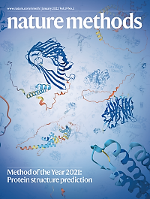







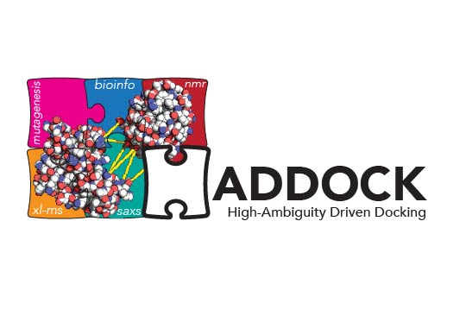

Advancements That Make This Possible…
Protein Structure Prediction
and Docking
(AlphaFold2, RoseTTAFold,
HADDOCK, LightDock, etc.)
Cloud Scalability
(Kubernetes, Docker,
Spark, CUDA, etc.)
Automatable/Explainable AI
(AutoML, Ensemble Learning,
SHAP, etc.)

Slide 8

Updating Malaria Vaccines and Diagnostics using Sequence and Structural Analysis
Ford et al. (2021) doi: 10.3389/fitd.2021.707313
Dieng and Ford et al. (2021) doi: 10.1101/2021.12.29.474460

Slide 9
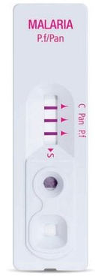
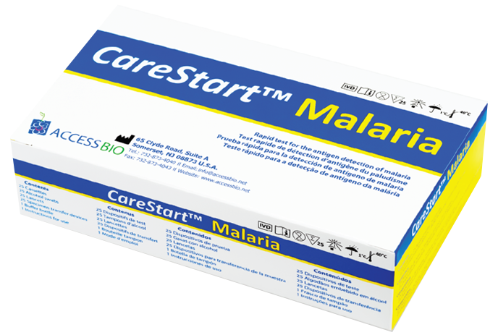
The Problem
Diagnostic Test Issues
Some Rapid Diagnostic Tests (RDTs) that diagnose Plasmodium falciparum-based malaria are based on detection of motif repeats in the Histidine Rich Protein 2 (PfHRP2).
Since 2005, the accuracy of these RDTs has been decreasing due to mutations in this protein and the diminishing presence of the motifs.
So, how do we pick better motifs for new RDTs?
Type | Motif
Type 2 | AHHAHHAAD
Type 7 | AHHAAD

Slide 10
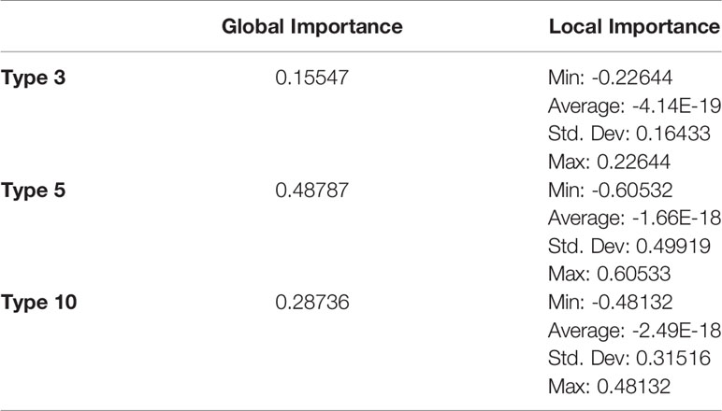
Our Investigation
Sample | Type 1 | Type 2 | … | Type 24
Sample 1 | 4 | 2 | … | 0
… | … | … | … | …
Sample 102 | 5 | 3 | … | 0
102 DNA Sequences
Count Motif Matches per Sample
Train ML Model to Predict Infection
+/-
Explain ML Model to Find Important Motif Types

Slide 11
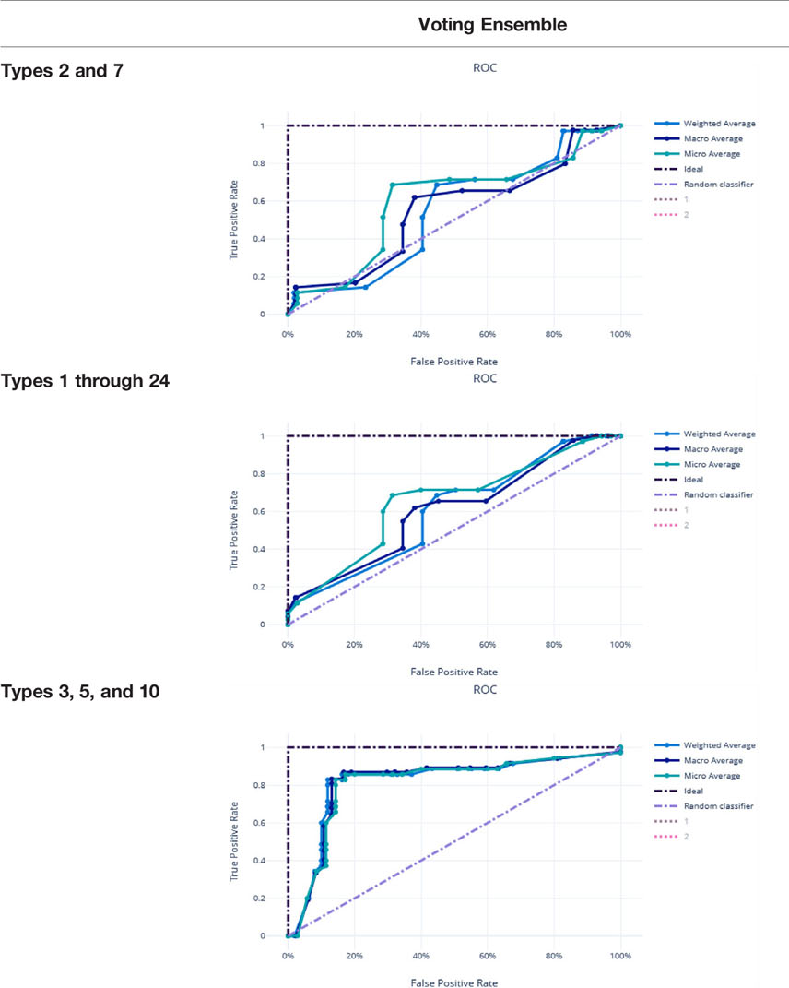
Model Performance Comparison
We can’t test for everything in an RDT, so which motifs give us the best diagnostic power?
Type | Motif
Type 3 | AHHAHHAAY
Type 5 | AHHAHHASD
Type 10 | AHHAAAHHEAATH

Slide 12
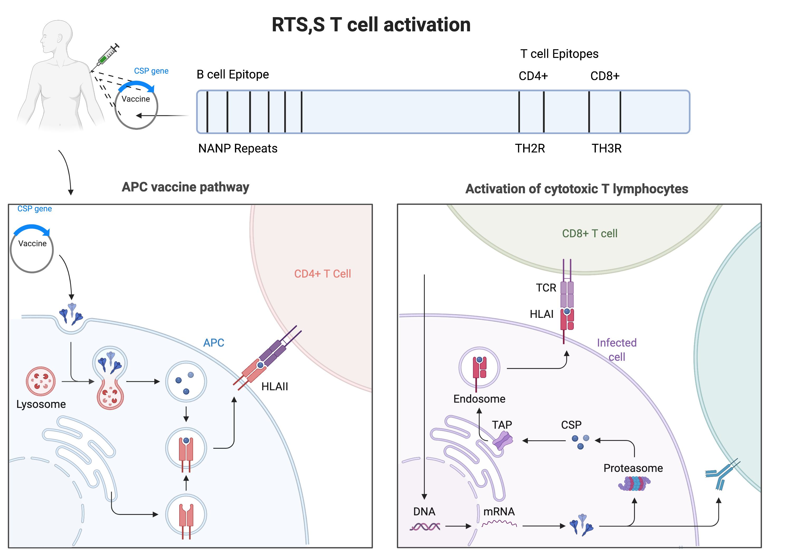
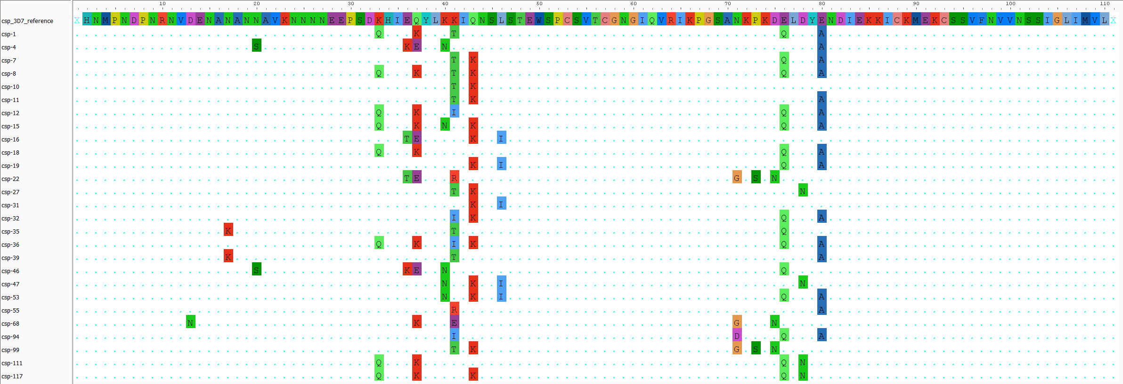
The Problem
Vaccine Efficacy Woes
CD4+
CD8+
The RTS,S vaccine, in Ghana, has a low efficacy (~30%).
The RTS,S vaccine is based on the Plasmodium falciparum 3D7 reference Circumsporozoite Surface Protein (PfCSP).
None of our Ghanaian isolates (haplotypes) matched 3D7.
See where I’m going with this?
HLA-II
HLA-I
Lysosomal
Degradation
Proteasomal
Degradation
Th2R
Th3R

Slide 13

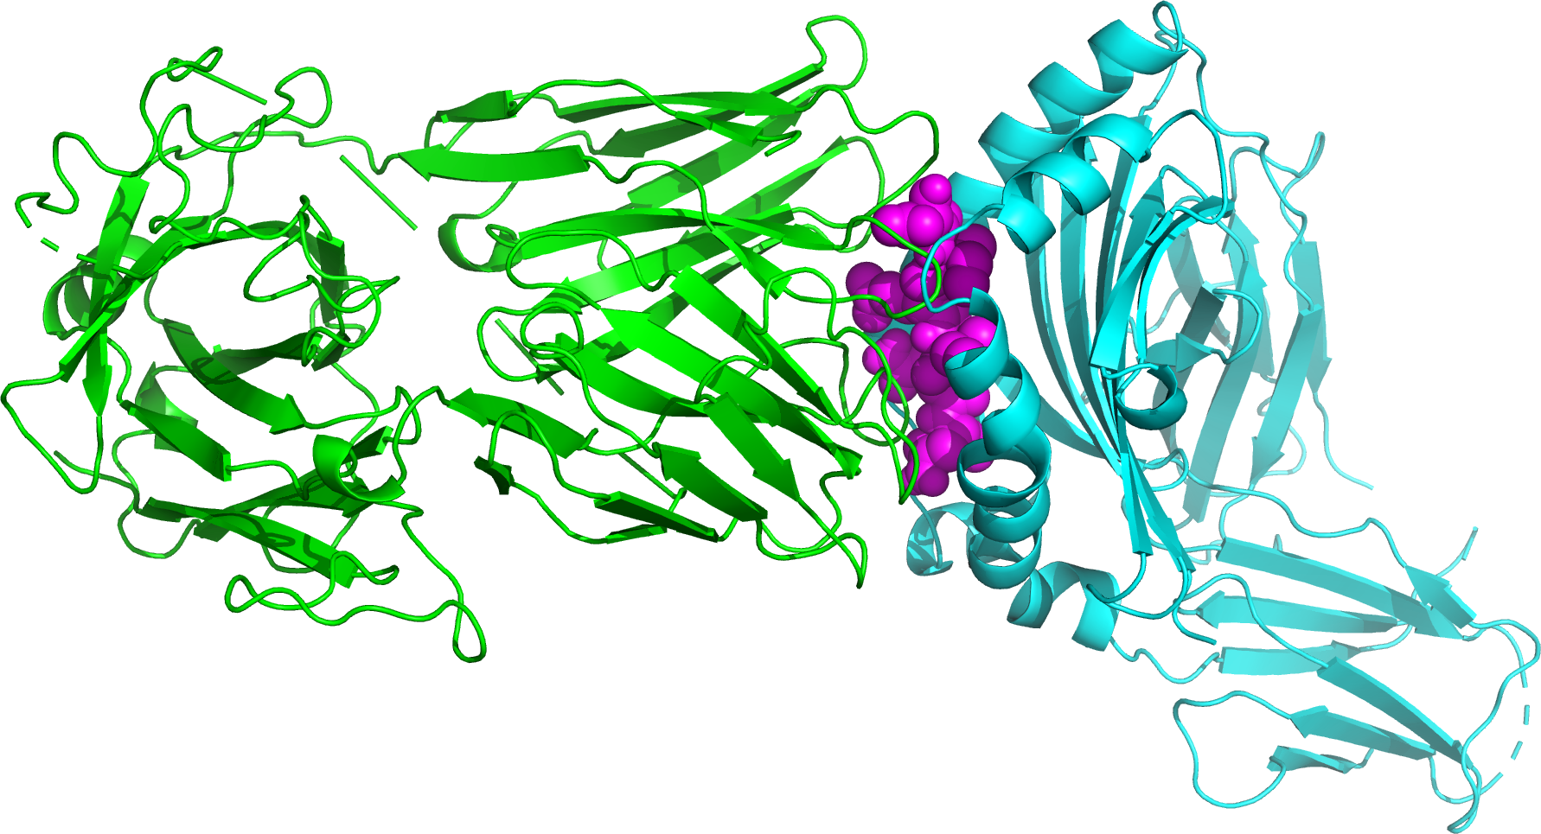
Our Investigation
Find
SNP-based Haplotypes
Filtering and Alignment
CSP Haplotype:
CSP Peptide:
Find CSP Haplotypes
(using HaplotypR)
Filter CSP Haplotypes
Append Reference Sequence
Align Haplotypes to Reference
Docking:
Simulate Degradation and Predict Structure
Protein-Protein Interaction, Docking, and Comparison
TCR
CSP
HLA
Predict CSP haplotype
peptide structures
(using NetChop and PeptideBuilder)
Predict binding affinity between
HLA, CSP peptide, and TCR
(using HADDOCK) and compare

Slide 14
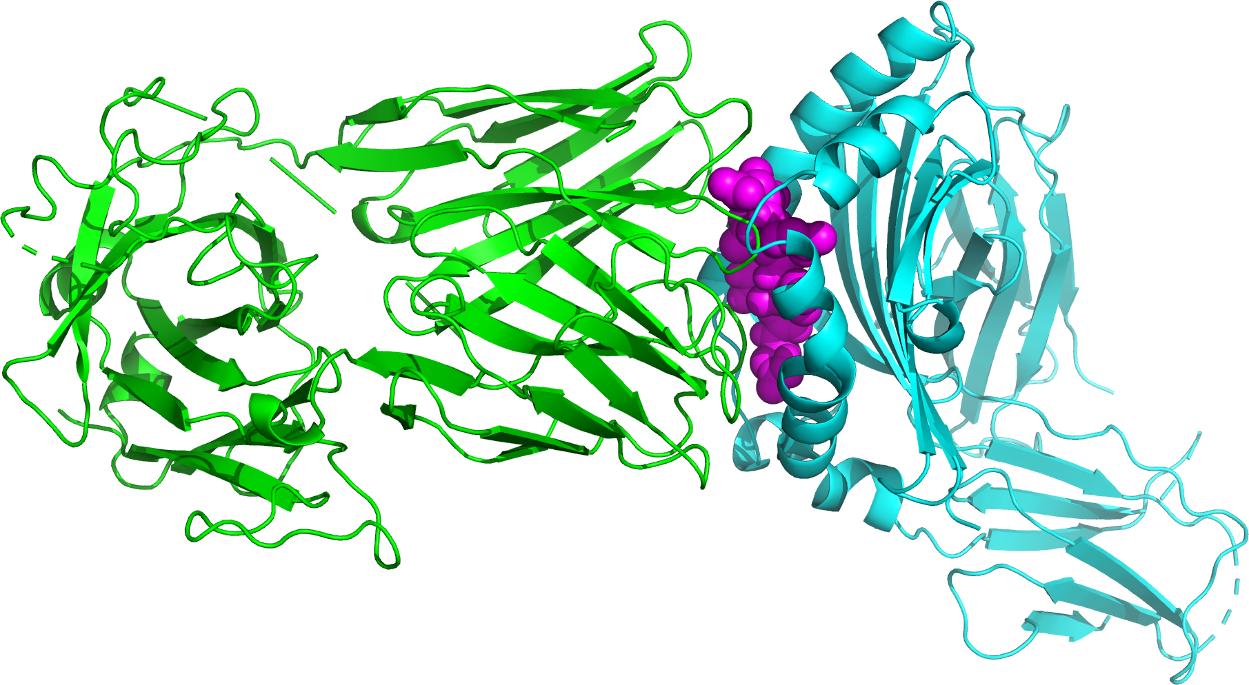
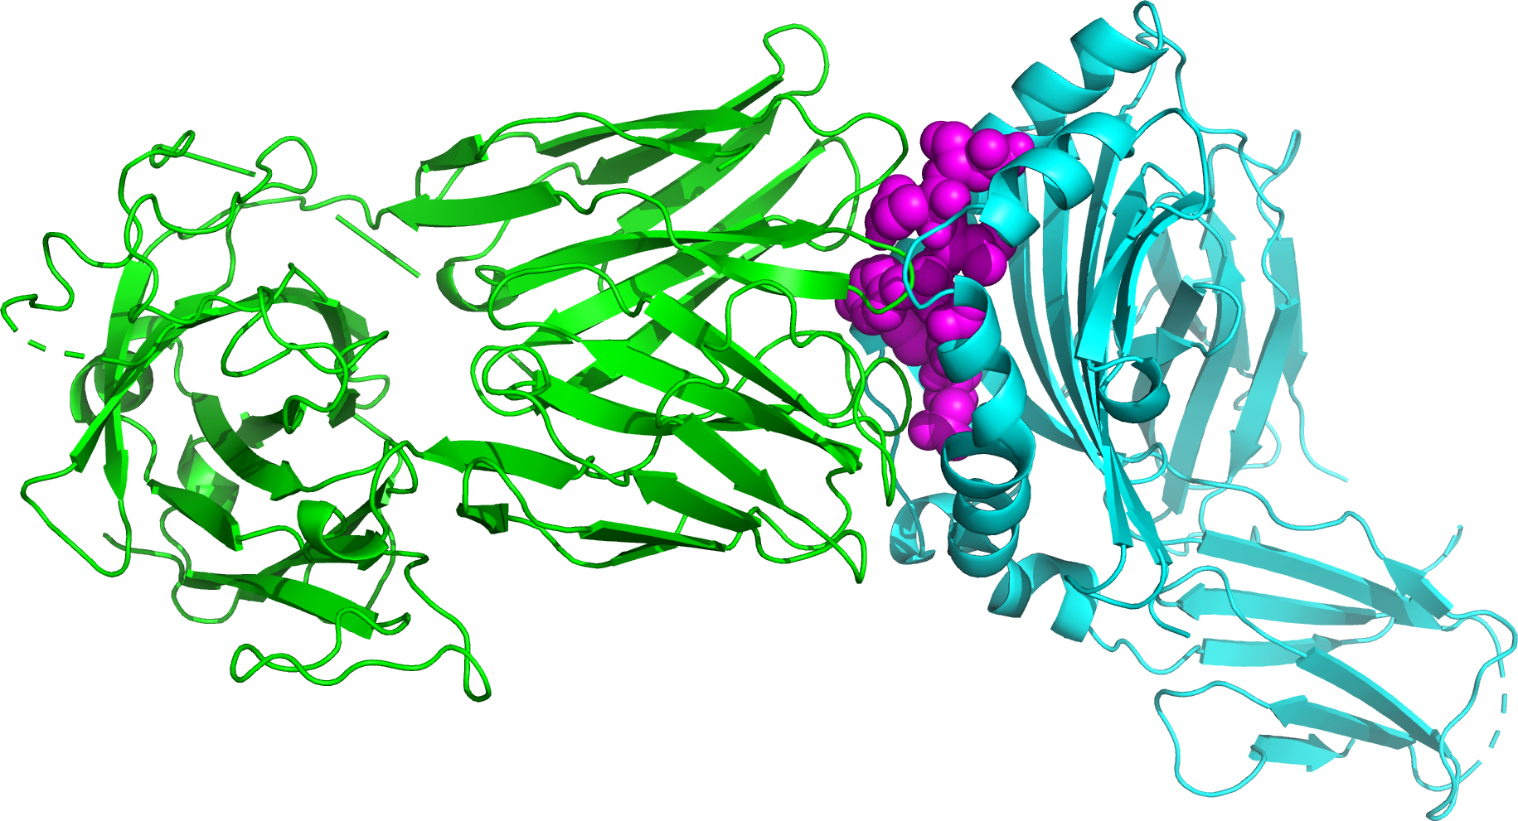
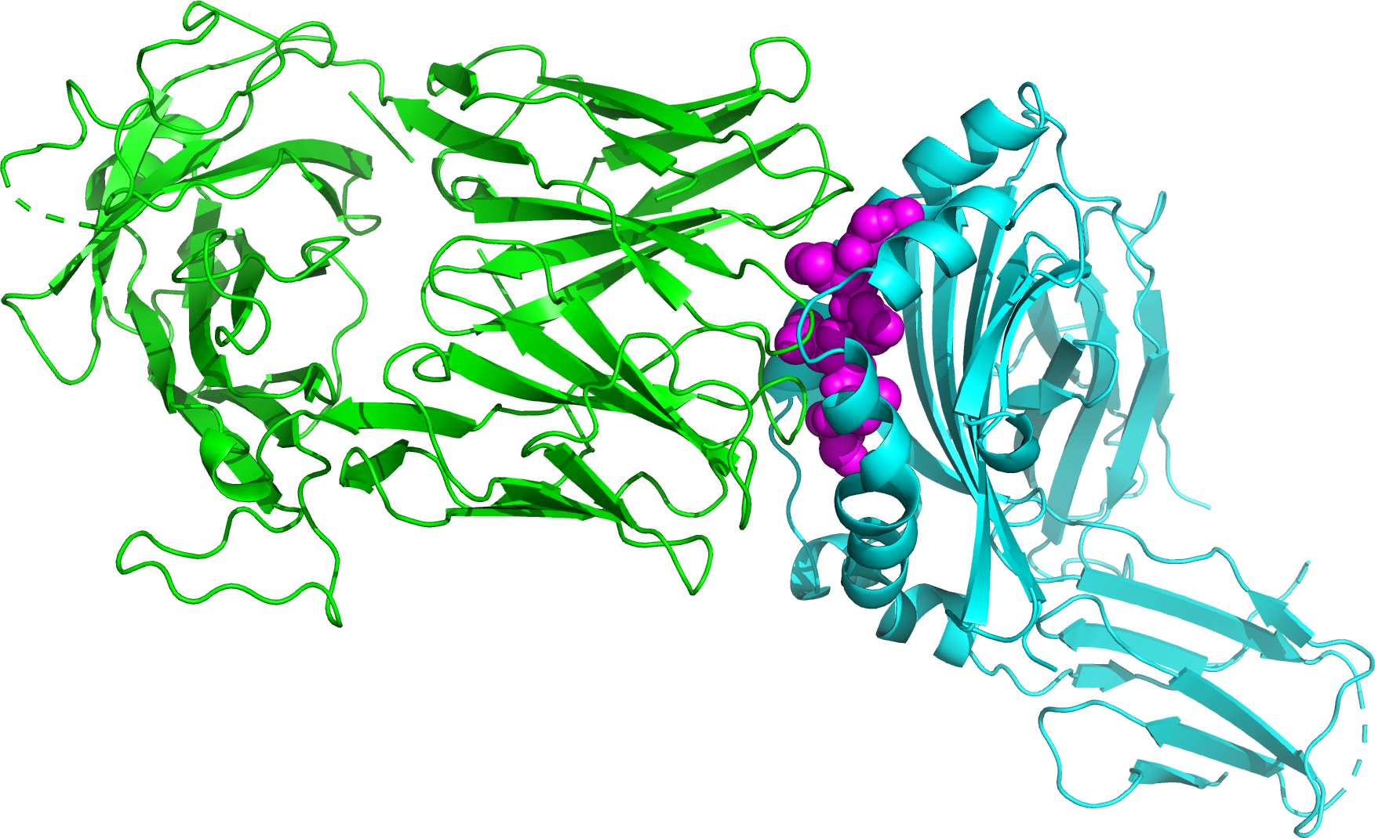
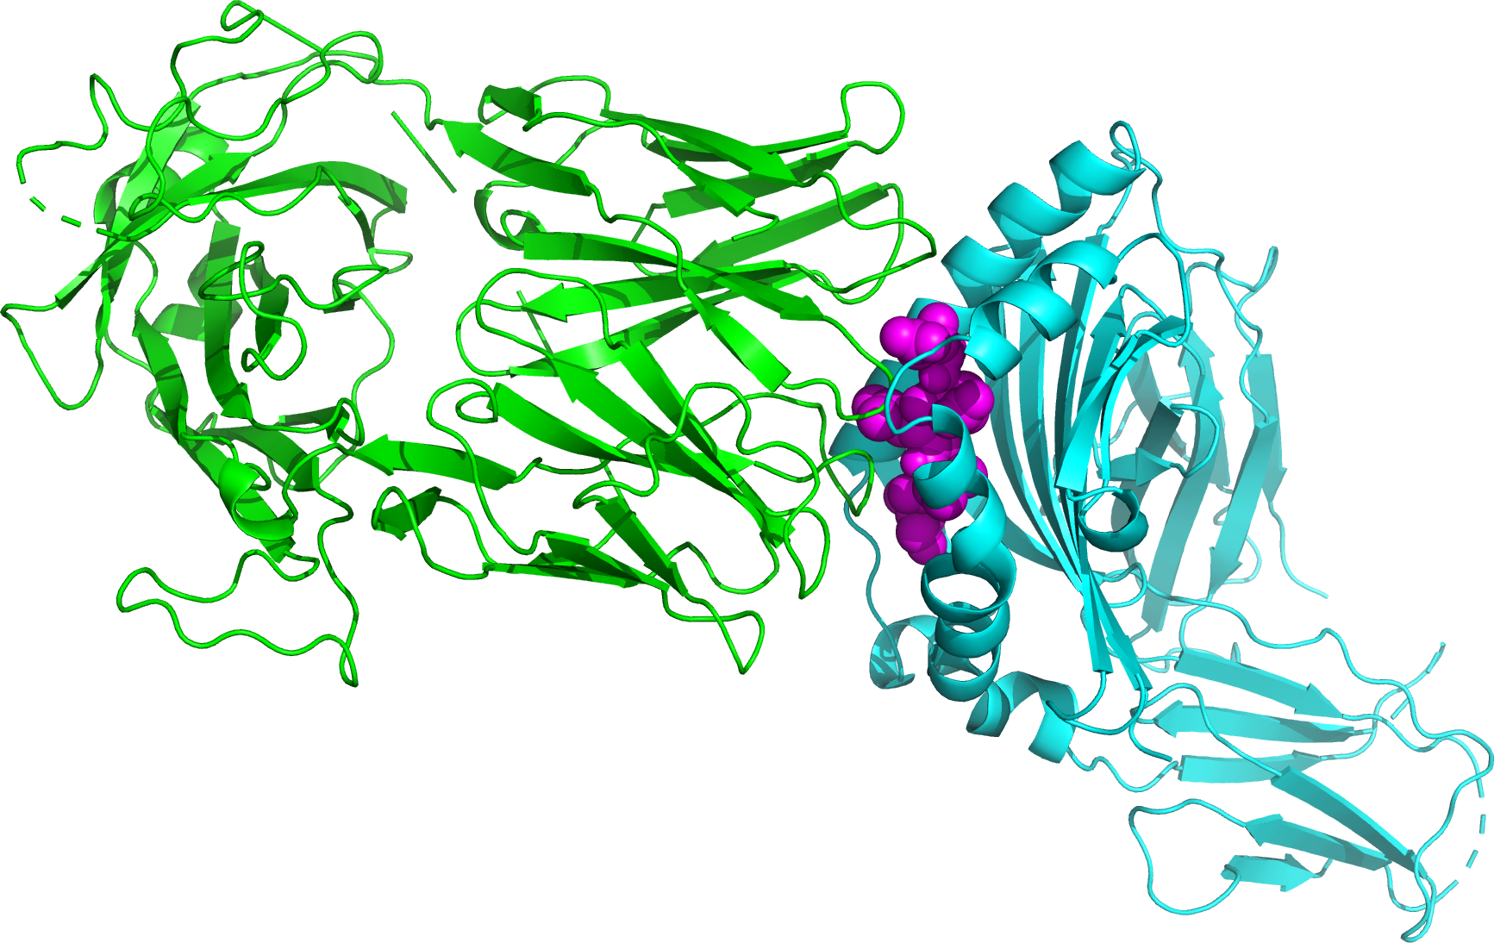
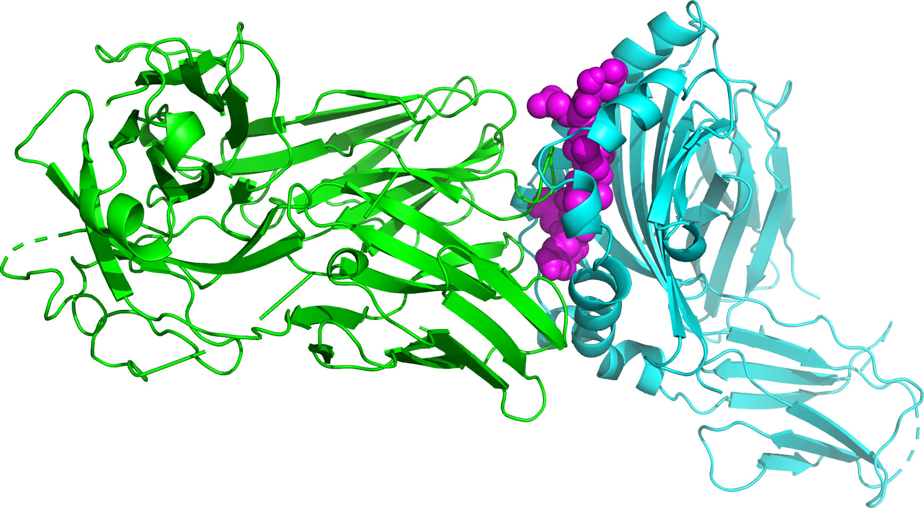
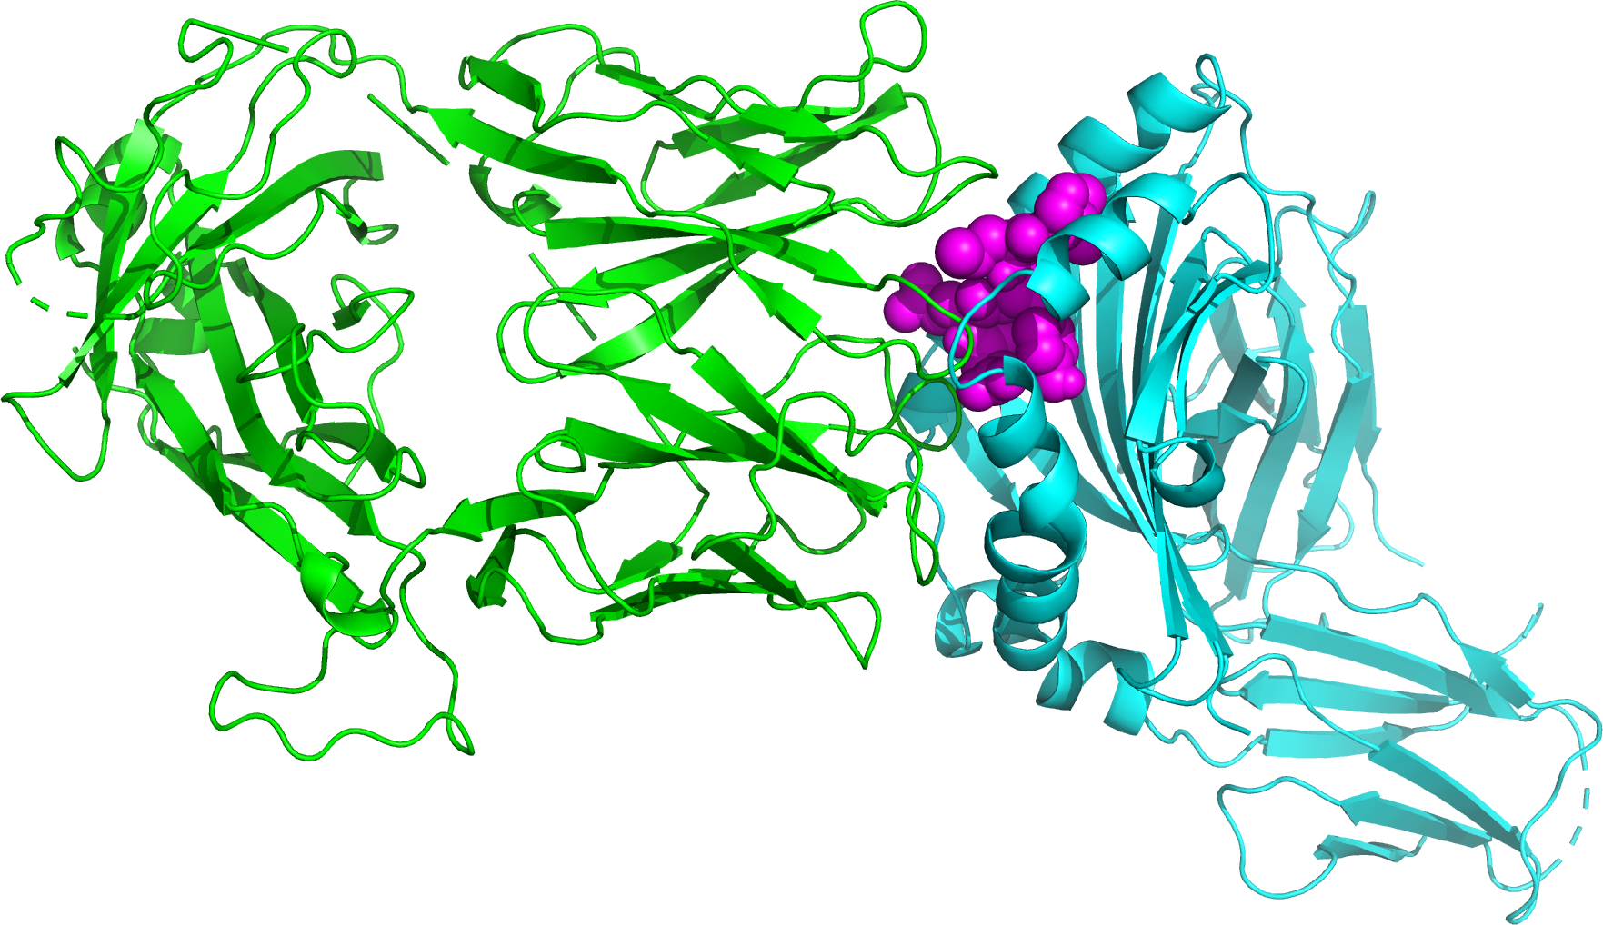
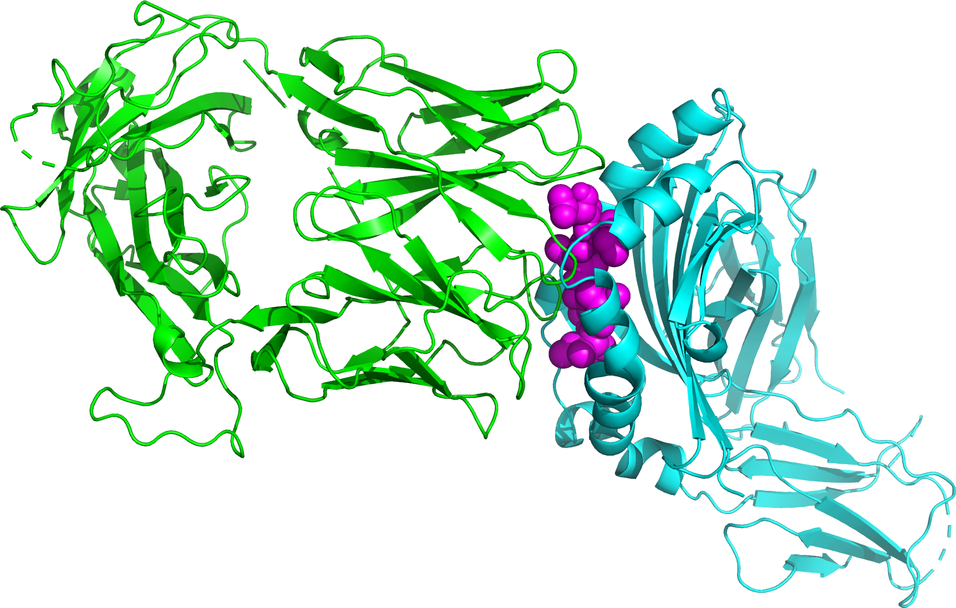
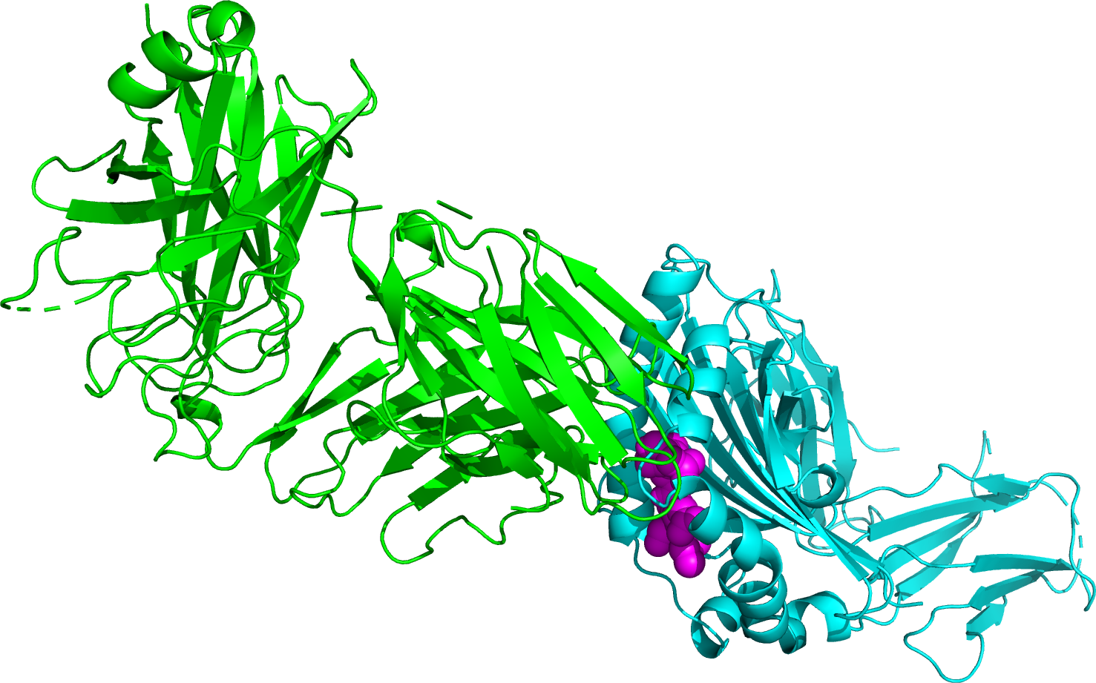
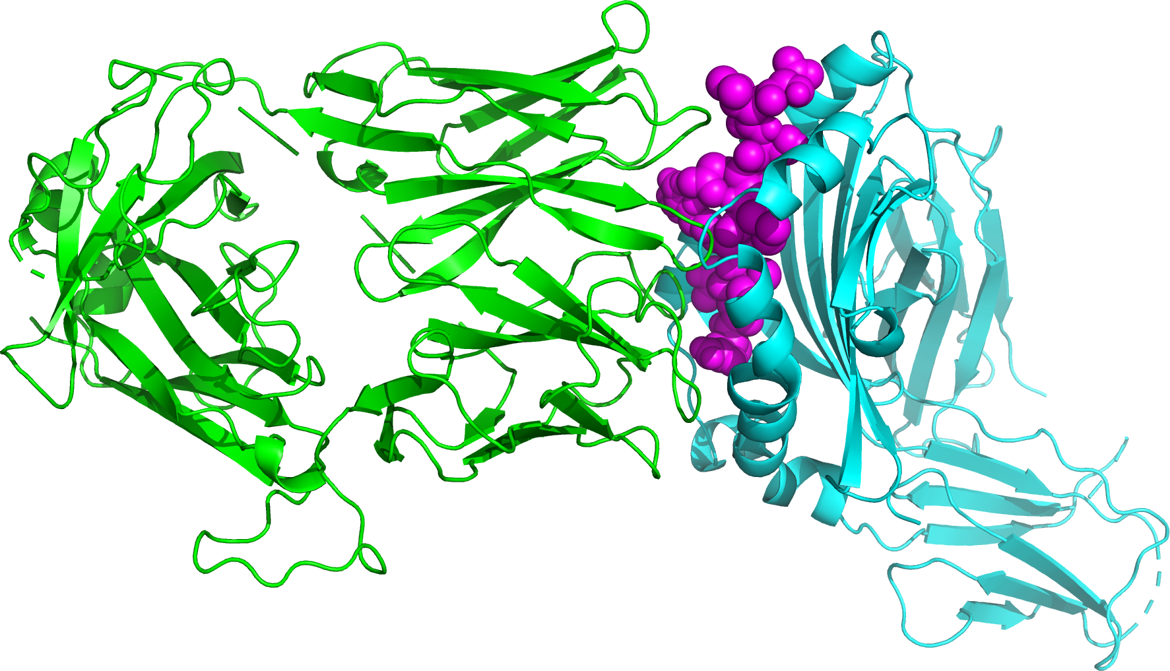
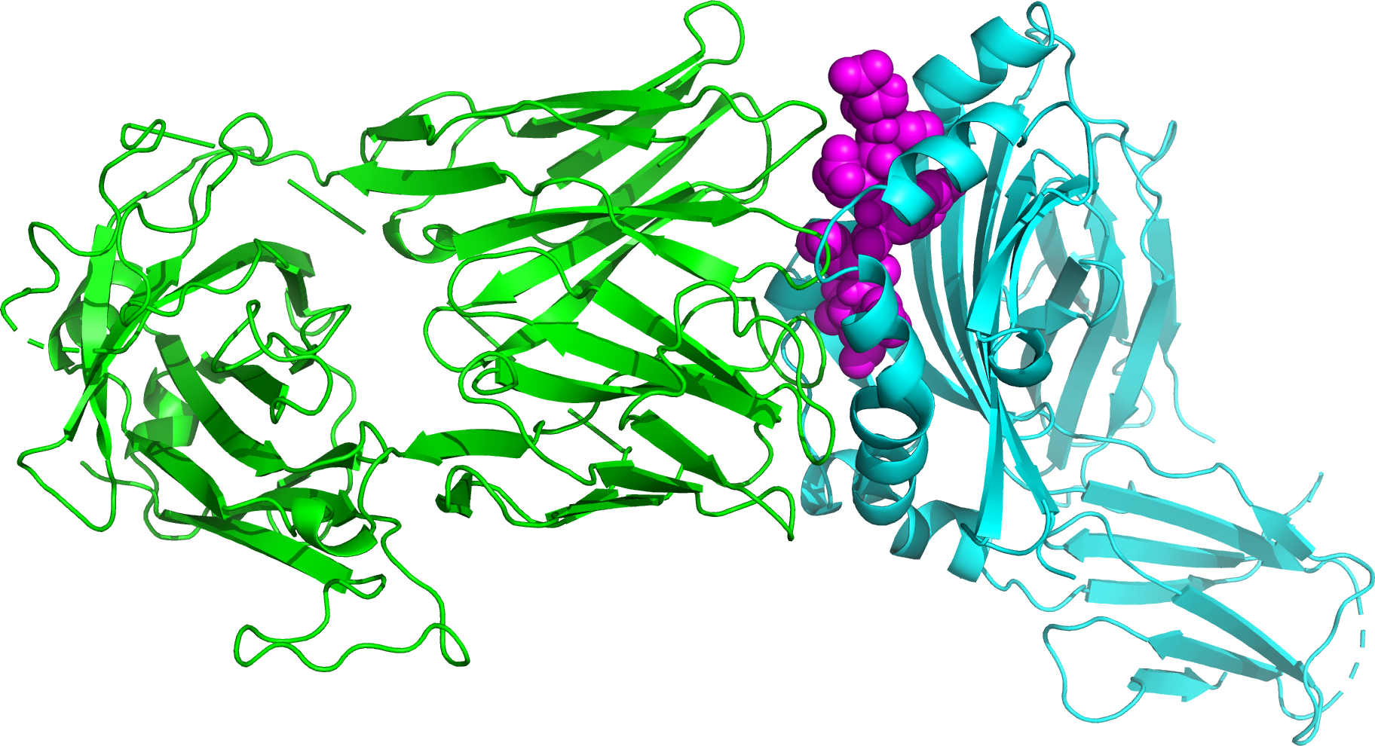
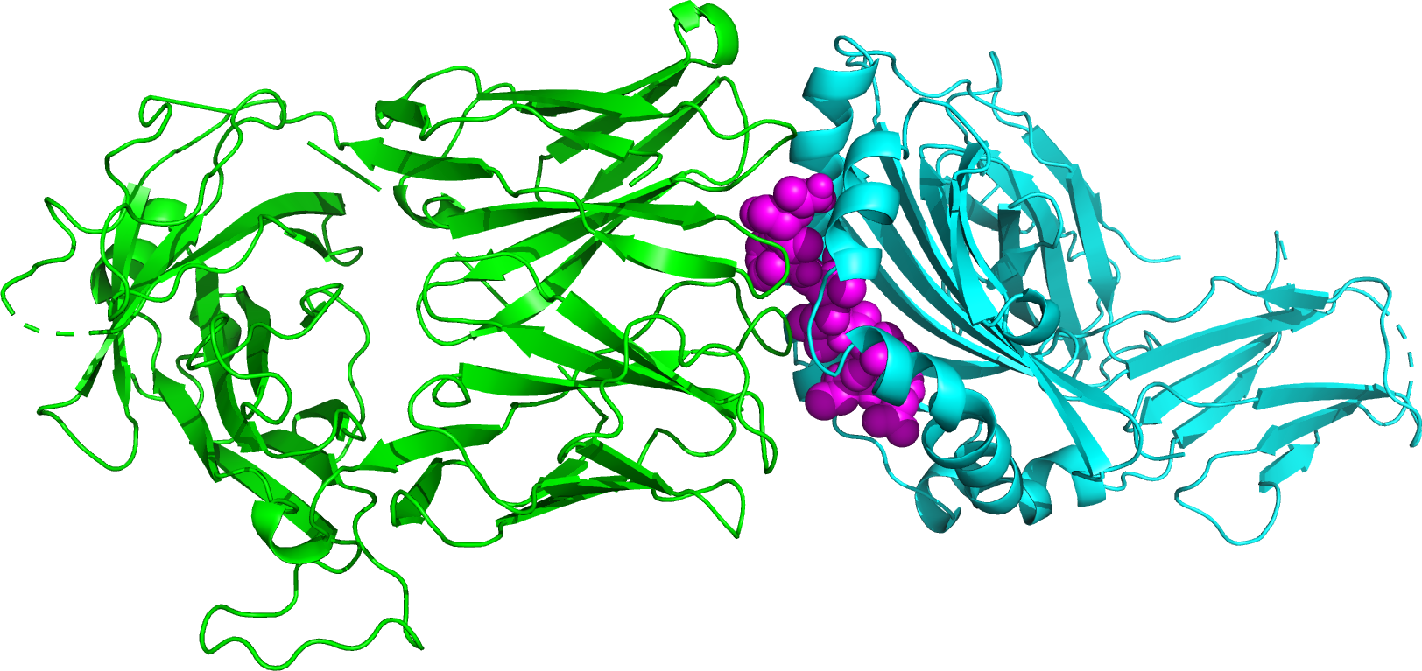

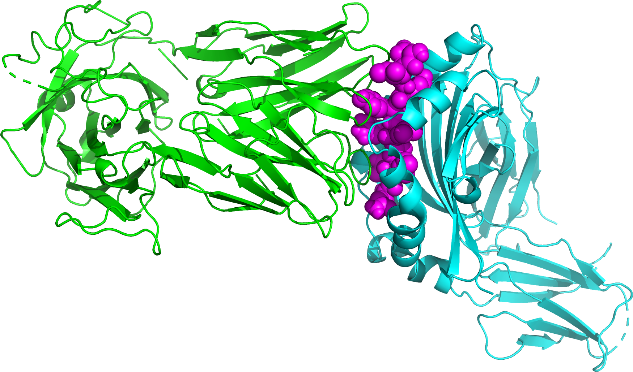

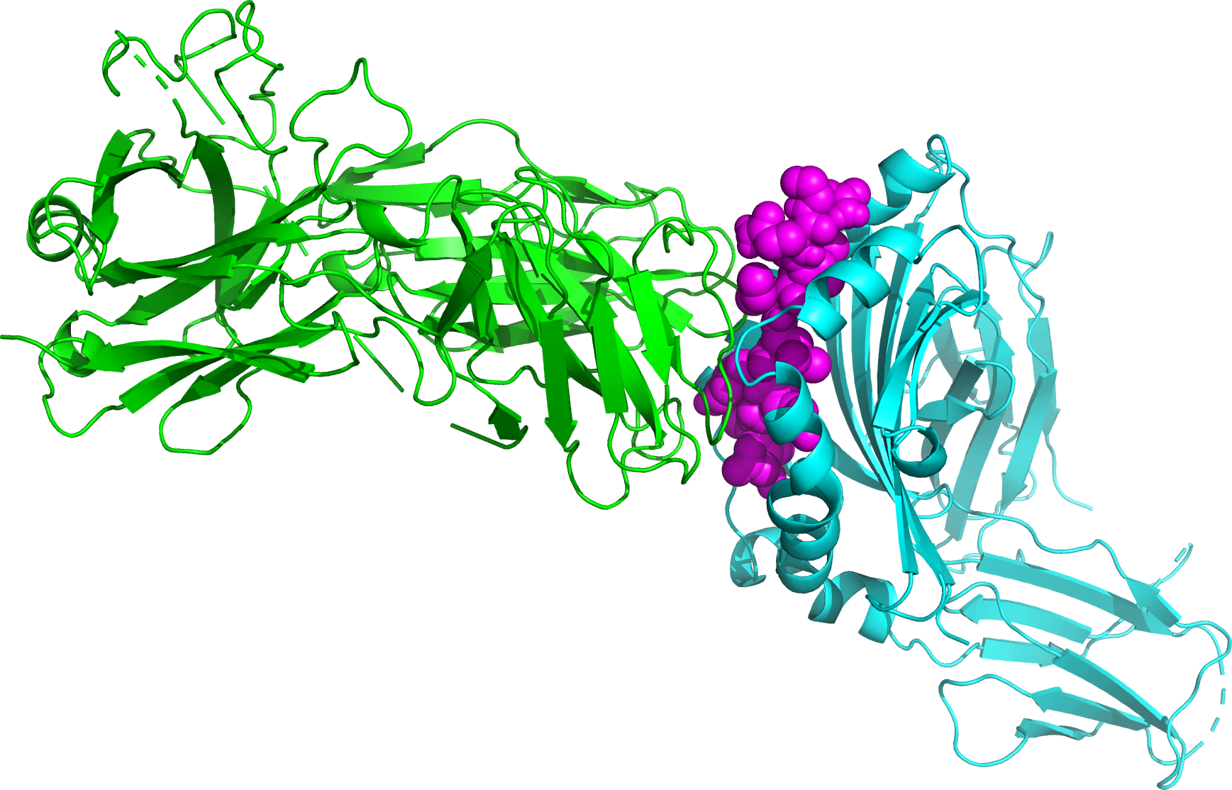
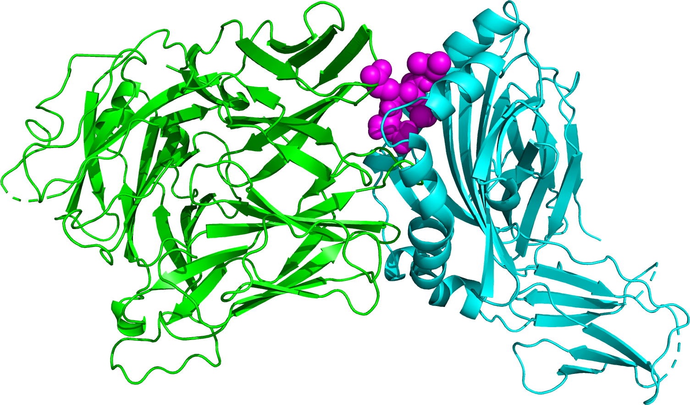
HLA-CSP peptide-TCR Complexes
CSP 3D7 Ref | CSP-1 | CSP-4 | CSP-7 | CSP-8 | CSP-12
CSP-15 | CSP-16 | CSP-19 | CSP-22 | CSP-32 | CSP-35
CSP-47 | CSP-55 | CSP-68 | CSP-94 | CSP-117 | Other Info: CD4+ T Cell HLA-DRB1 Th2R Region

Slide 15
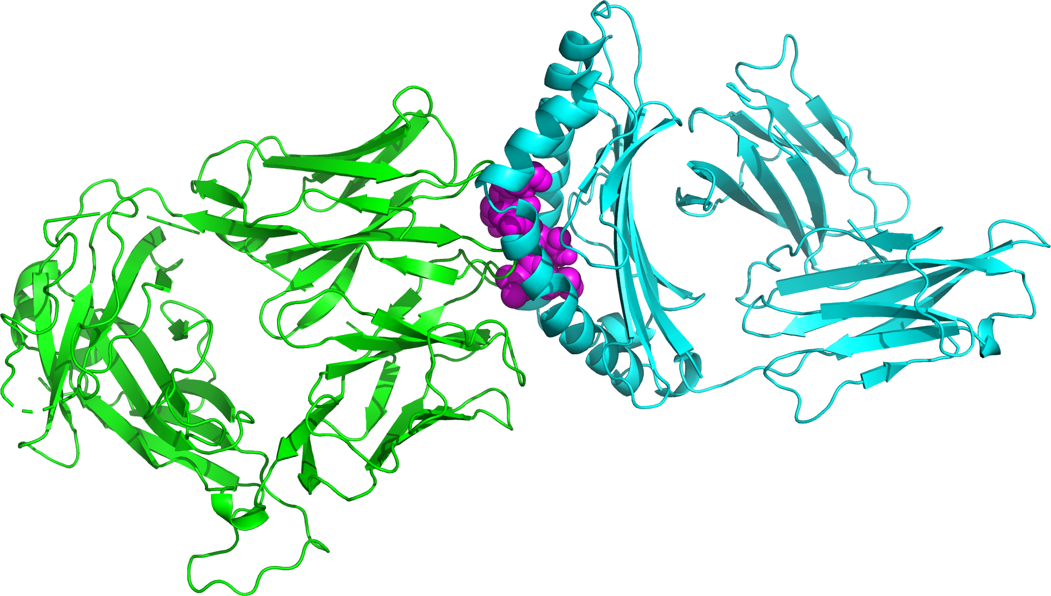
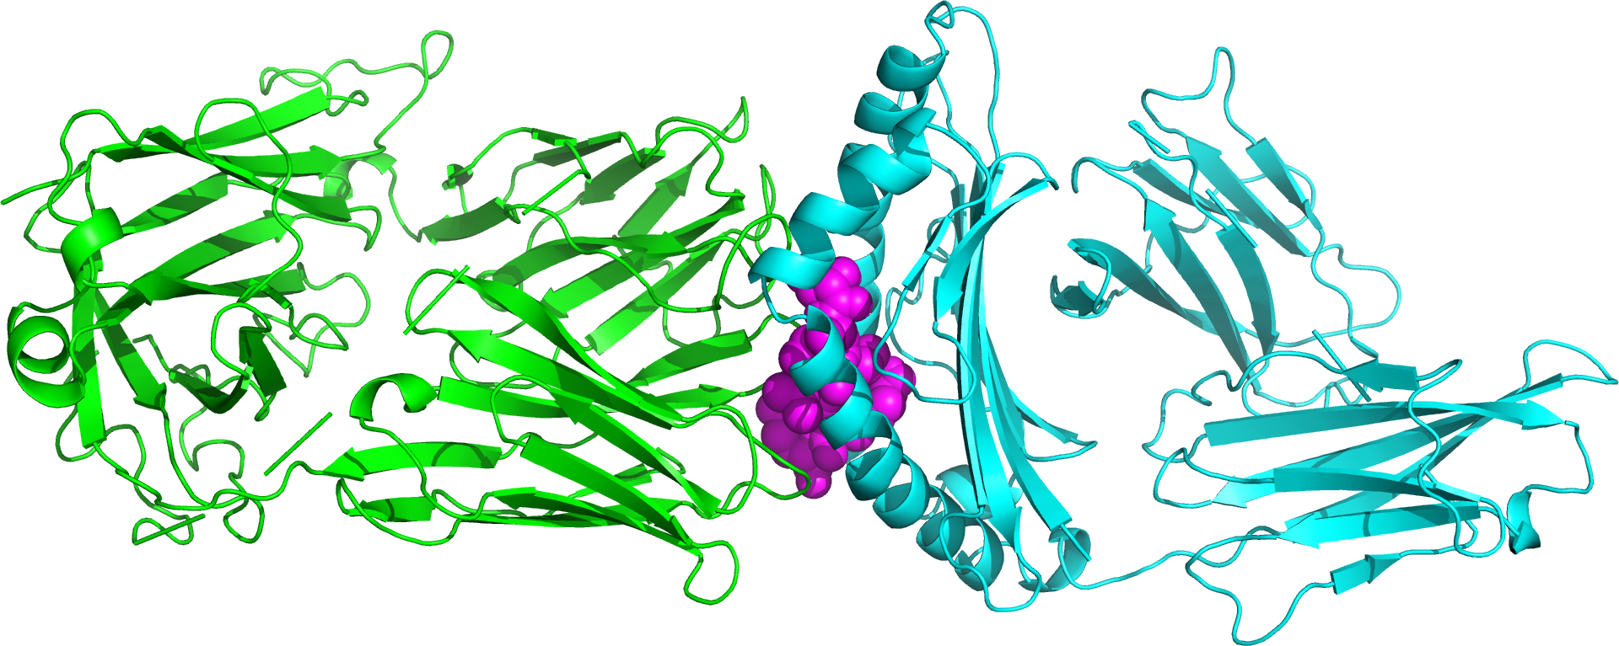
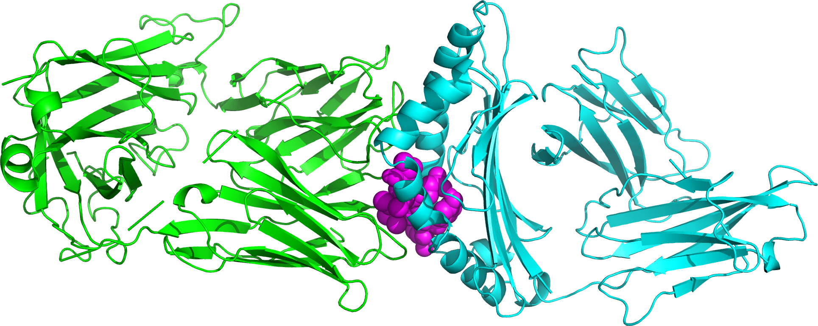
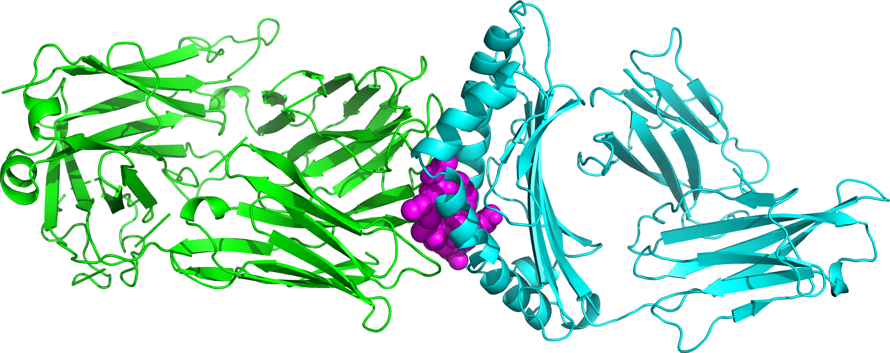
HLA-CSP peptide-TCR Complexes
CSP 3D7 Reference | CSP-1
CSP-4 | CSP-35
Other Info:
CD8+ T Cell
HLA-A2
Th3R Region

Slide 16
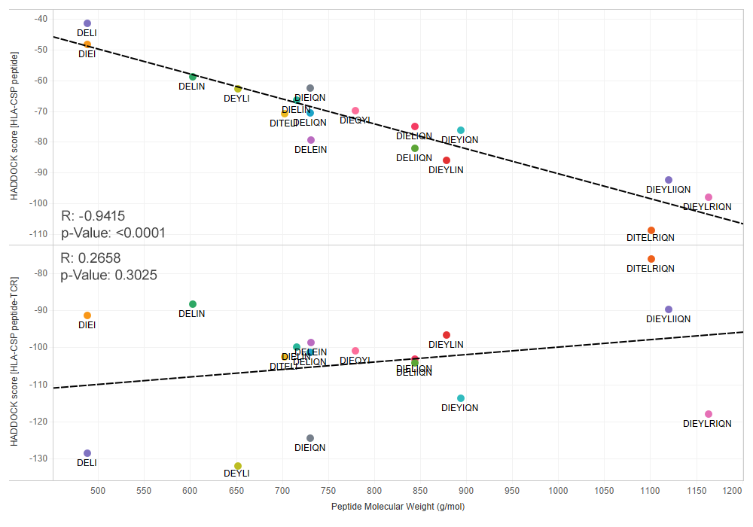
“The Goldilocks Approach”
Pick a common haplotype that renders a medium-sized peptide for optimal binding between the HLA and TCR proteins.
Example:
CSP-35, 39
● DIELIQN
Found in 29% of our samples

Slide 17

Structural Analysis and Antibody Binding of SARS-CoV-2 Variants
Ford et al. (2022) doi: 10.3389/fviro.2022.830202

Slide 18



The Problem
Variants, Variants, and More Variants
SARS-CoV-2 variants are popping up quickly and sporadically (such as Omicron on Nov. 22nd).
Sequence information comes out way before structural information (or antibody testing).
For public health reasons, we need to act quickly to identify variants of concern and answer questions around vaccine efficacy, transmissibility, pathogenicity, etc.
So, how do we predict if a variant is serious?
Α
Β
Δ
Ο

Slide 19
Example Pipeline
Target Structure
PDB
Input Sequences
Structural Prediction
Predicted Structures
Structure Comparison / Validation
Docking Prediction
FASTA
PDB
AlphaFold2,
RoseTTAFold
PyMol
LightDock, HADDOCK, Megadock
Reference Structure
Predicted Docking Metrics
PDB
CSV
Predicted Docking Structures
PDB

Slide 20
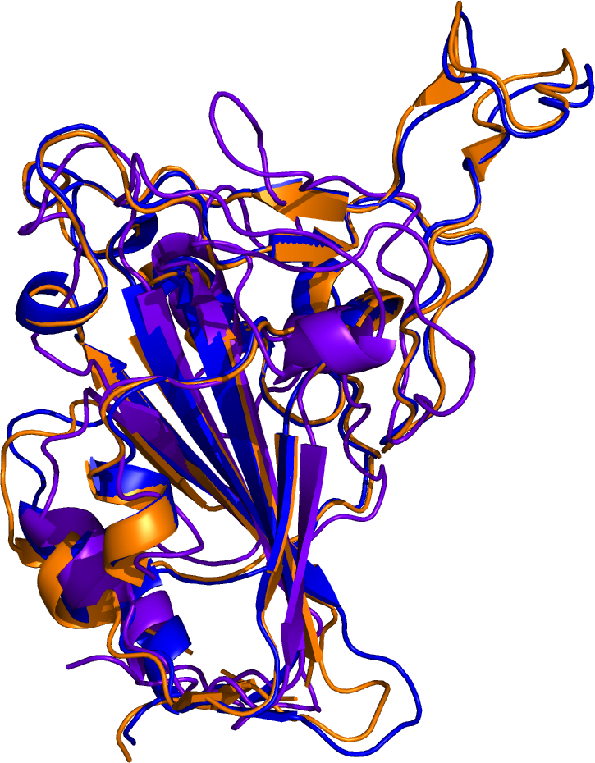
Receptor Binding Domain Structural Prediction
>B.1.1.529 - Spike RBD
DEVFNATRFASVYAWNRKRISNCVADYSVLYNLAPFFTFKCYGVSPTKLNDLCFTNVYADSFVIRGDEVRQIAPGQTGNIADYNYKLPDDFTGCVIAWNSNKLDSKVSGNYNYLYRLFRKSNLKPFERDISTEIYQAGNKPCNGVAGFNCYFPLRSYSFRPTYGVGHQPYRVVVLSFELLHAPATVCGPK
AlphaFold2
RoseTTAFold
PDB
PDB
RMSD: 0.527
RMSD: 3.329
Actual Structure
PDB: 7T9J
Published: 12/31/21

Slide 21
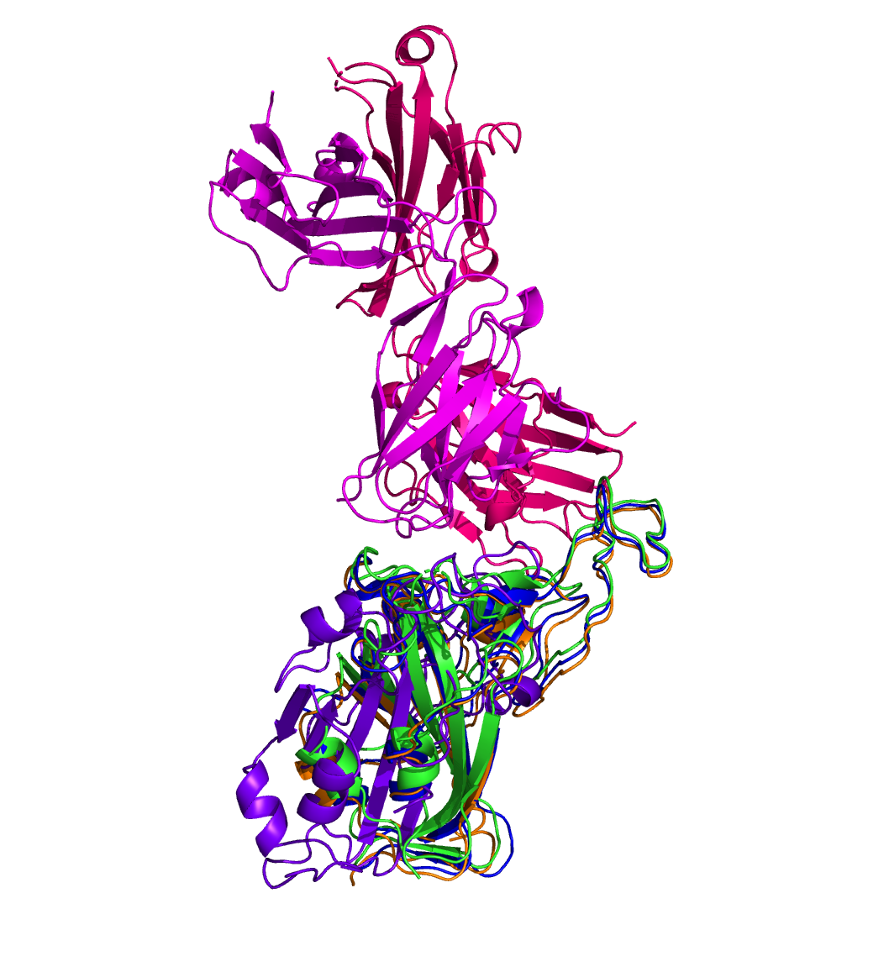
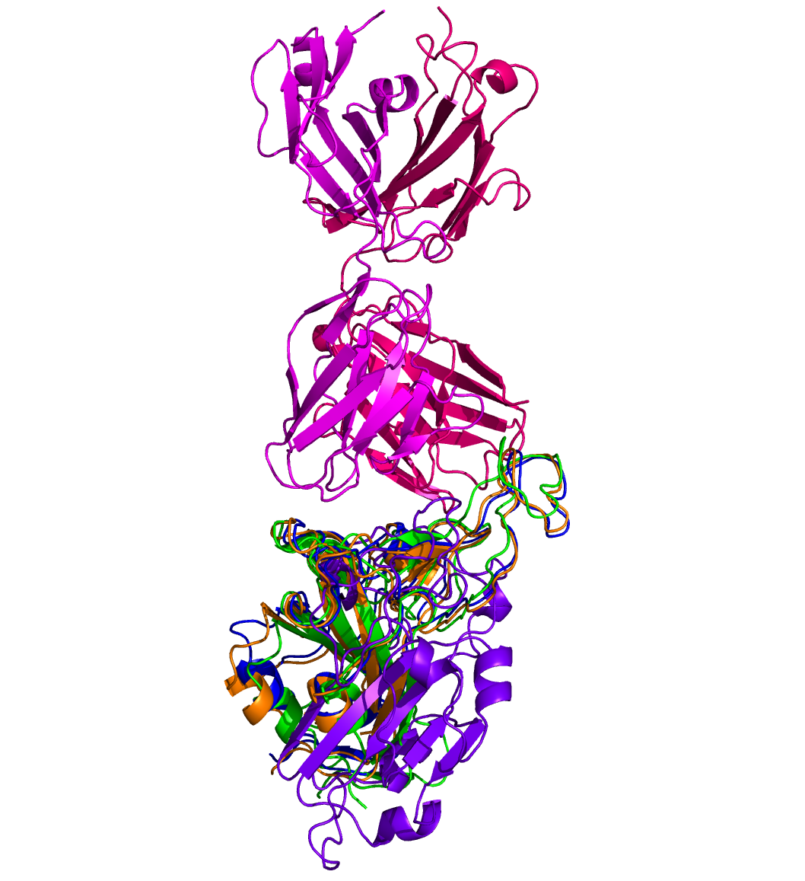
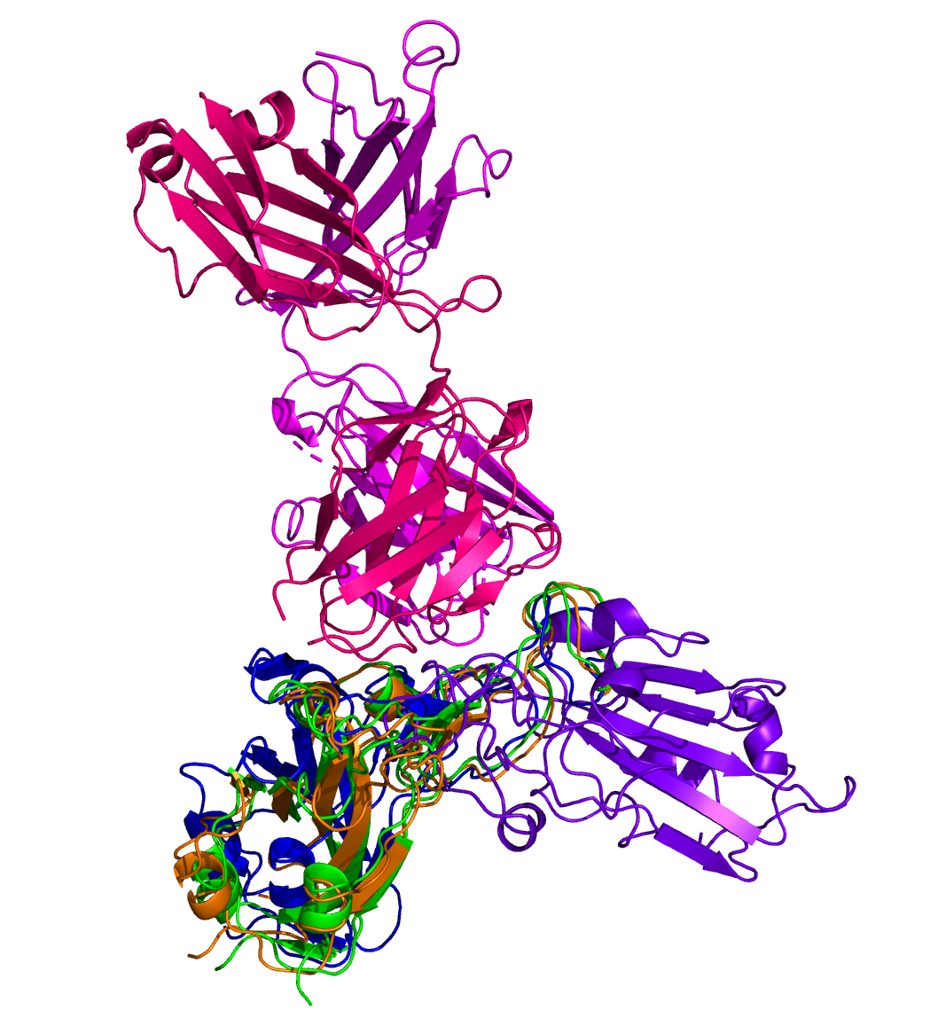
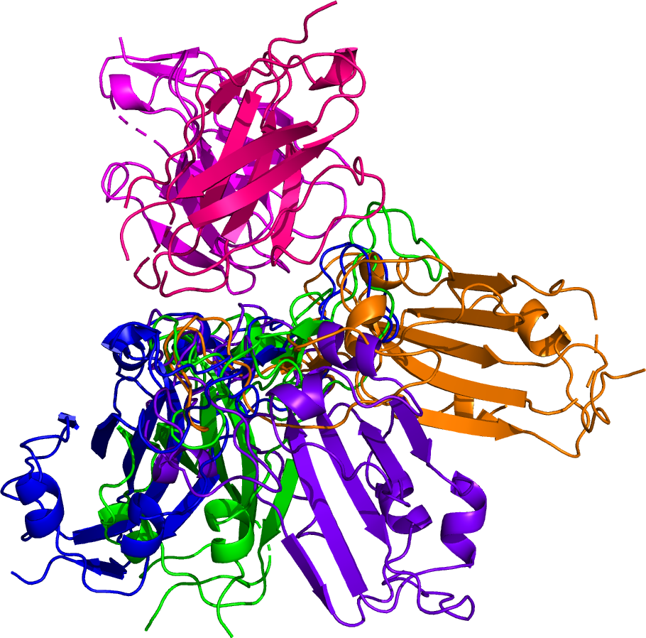
Neutralizing Antibody Docking
Actual Alpha (PDB: 6XC2) | Predicted Omicron (AlphaFold2) | Predicted Omicron (RoseTTAFold) | Actual Omicron (PDB: 7T9J)
H Chain | L Chain
C105 (Fv only; PDB: 6XCM) | CC12.1 (PDB: 6XC2) | CC12.3 (PDB: 6XC7) | CV30 (PDB: 6XE1)

Slide 22
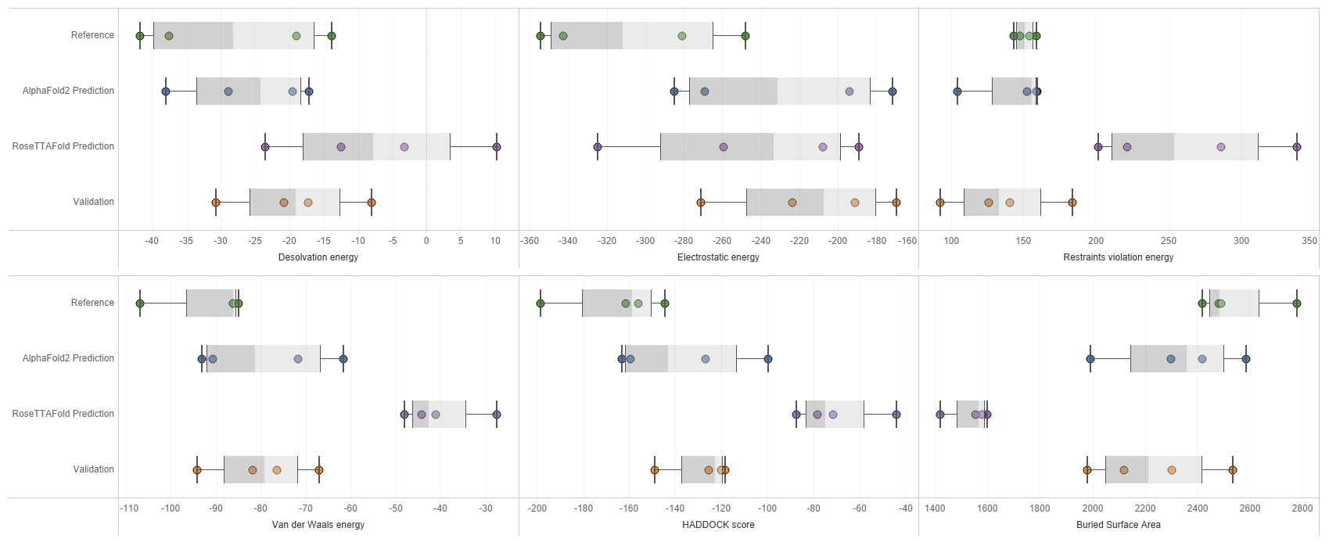
Predicted Docking Metrics
Actual Alpha (PDB: 6XC2) | Predicted Omicron (AlphaFold2)
Predicted Omicron (RoseTTAFold) | Actual Omicron (PDB: 7T9J)

Slide 23







Therapeutic Design Opportunities
1 Drug – Multiple Candidate Target Proteins
Multiple Drug Candidates – 1 Target
Binding Site / Epitope Prediction
Population Variant Analysis
AA
GA
GG

Slide 24
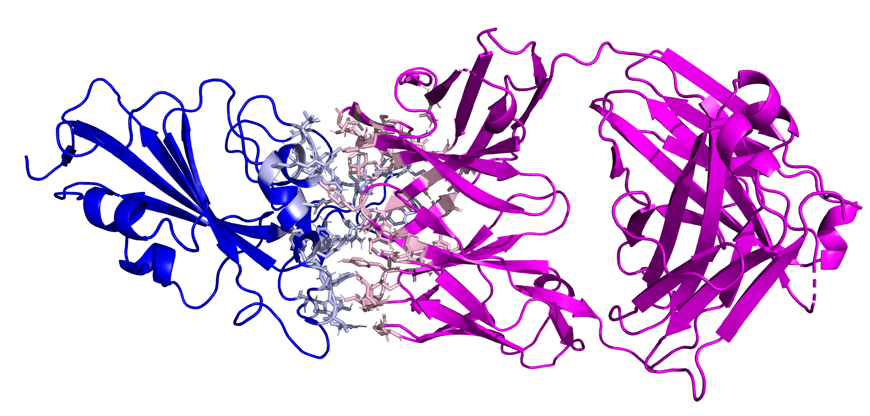
In Summary…
Structural Prediction and Docking:
These deep learning-based analyses allow us to make educated guesses in silico, reducing the amount of in vitro experimentation to be done.
We can now rapidly generate structures and dock them to therapeutics months before experimental results are available.
Machine Learning Model Explanability:
Deriving feature importance helps to pick out important features for designing diagnostic tests, vaccines, antibodies, and more.
Future Capabilities:
Enable full automation and cloud scalability of this pipeline for higher throughput testing capabilities. (azureml-alphafold2)
Enhance the docking capabilities to be faster and more reliable, especially when a binding site it known.

Slide 25

Questions?

